Slide 1
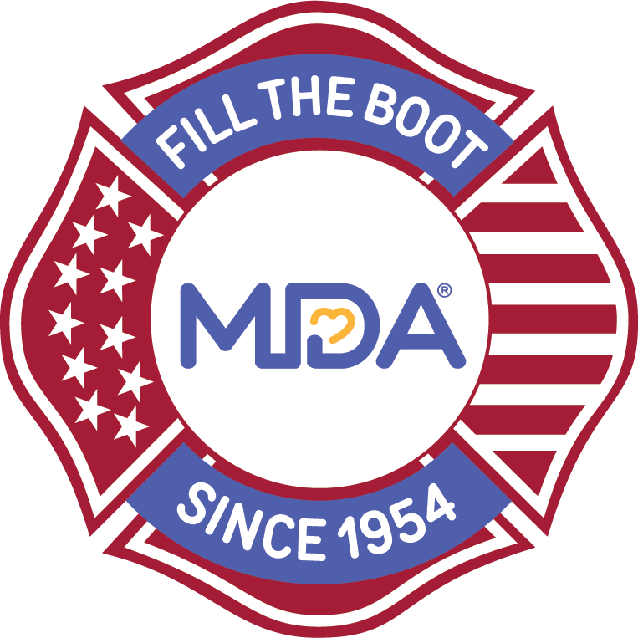
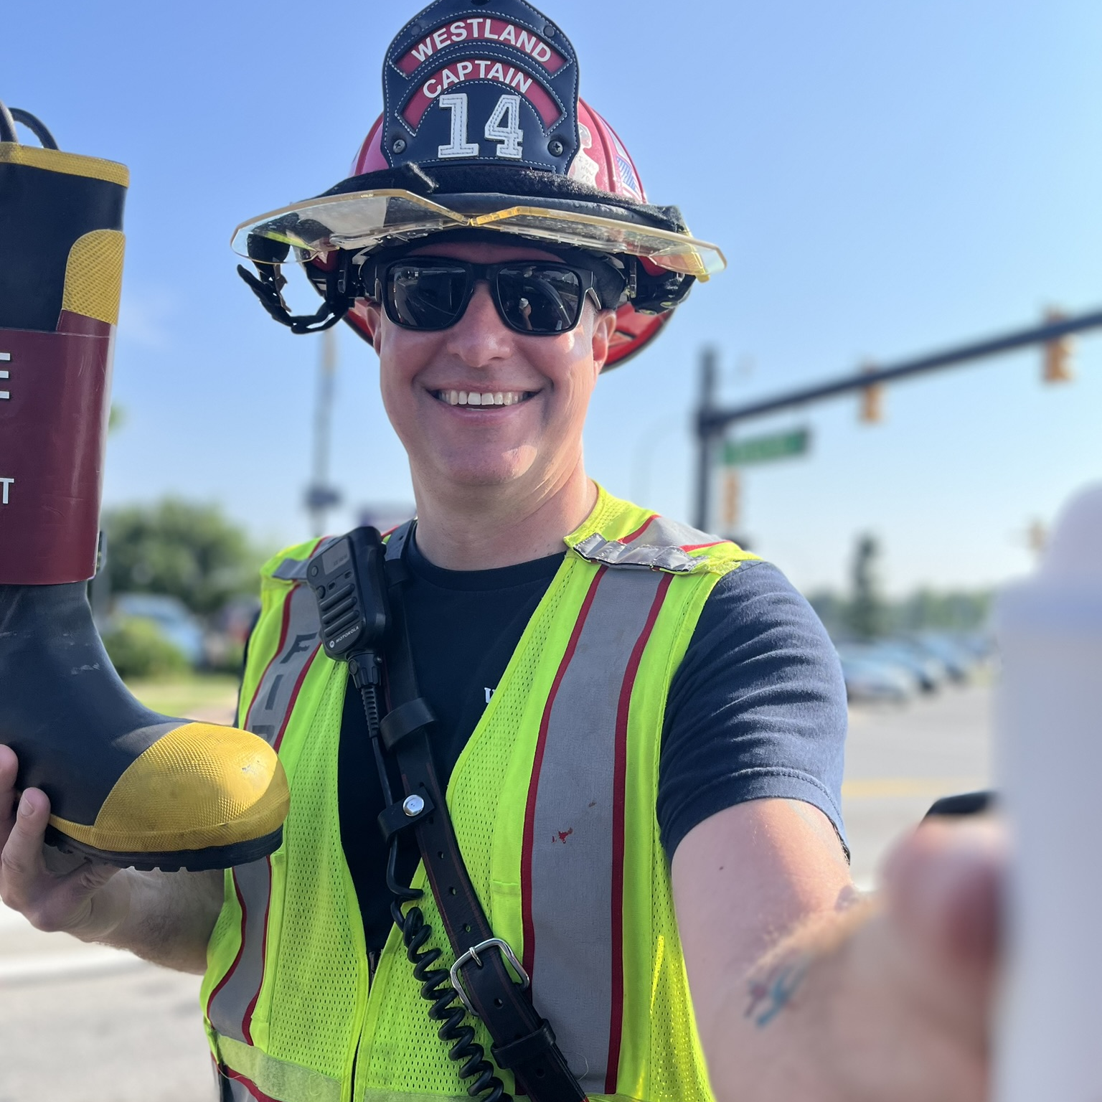

Fill the Boot for
Atwater City Council – May 11th, 2026
Notes:
Good evening Atwater City Council.
My name is Christina Mota, thank you for having me here this evening to speak on behalf of the MDA and the partnership with CAL FIRE MMU.

Slide 2
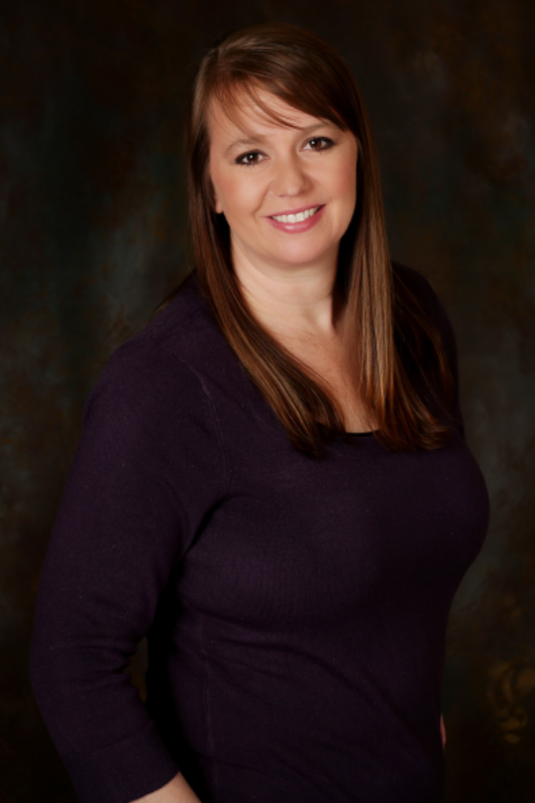
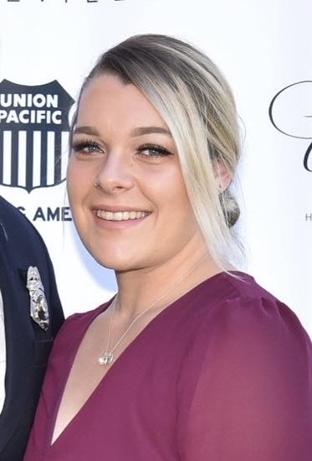
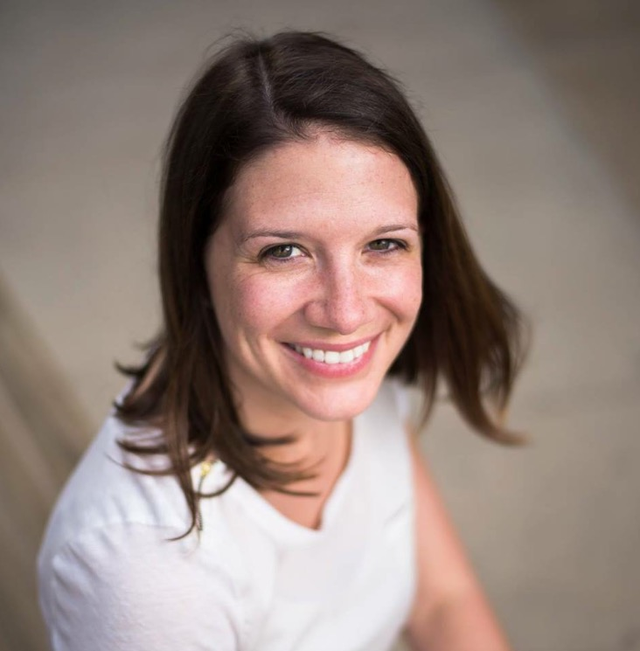
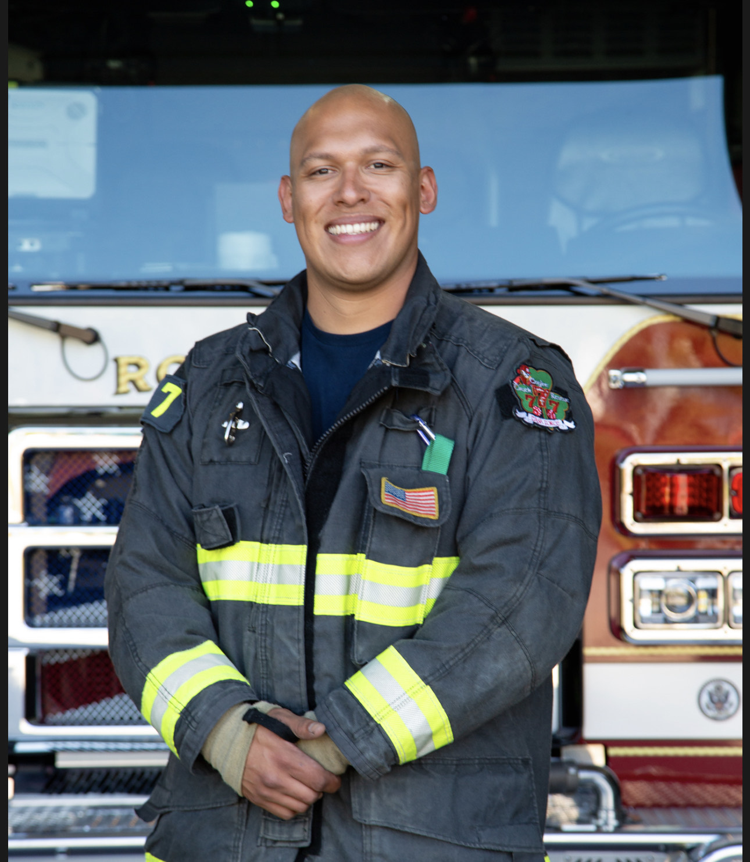
MDA Contacts
Angie Connell
  Account Director; 10th District
Christina Mota
  Account Manager, California
Sabrina Allen
  Senior Director, West Region
Angel Mota
  IAFF 10th District Coordinator
Notes:
Intros, growing team, etc
You can delete any contact photo/name/title that isn’t needed
Even if you are solo – this might be a good slide to include and highlight your AD, SD, VP, District Coordinator, State Coordinator, etc… anyone you want your audience to be familiar with
Introduce District Coordinator here if appropriate
Committed to supporting Fill the Boot success across the district
Provides guidance, support, and best practices to ensure successful events
Helps fire fighters make the biggest impact for MDA families in their communities

Slide 3
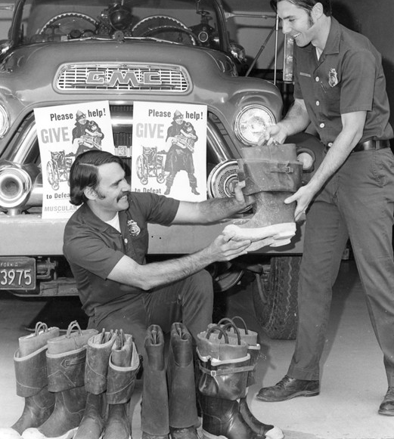
A Fire Fighter Tradition
Fire fighters collect donations using their boots at intersections, storefronts, and community events
Thousands of fire fighters across the country rally their communities each year to support MDA
Funds support groundbreaking research, critical care, and vital services for families living with neuromuscular diseases
Notes:
Angel Speak?

Slide 4
Why Fill the Boot?
  Tradition
  Over 70 years of partnership with MDA
  Ease
  A turnkey program with all supplies provided at no cost
  Visibility
  A chance to interact
  with the public in
  a non-emergency setting
  Competition
  The opportunity
  to out-fundraise the next
  town or station
  Altruism
  The drive to make
  a difference
  Comradery
  A way to bond
  with coworkers
  Connection
  Supporting a cause that
  affects someone you know
Notes:
Tradition: MDA is the IAFF charity of choice. And has committed to work until a cure is found.
Easy, turnkey program: We’ll talk more about available supplies in a minute
Great public relations: It’s a fun way to interreact with public when it’s not the worst day of their lives
Competition: Any body here competitive? Channel that drive to win into a competition with another station/local/department.
Altruism: Many of you became fire fighters because you wanted to help people – this is another great way to help!
Comradery: Allows you to bond with coworkers over a great cause
Personal Connection: Maybe you know someone affected by NMD. This is a great way to fight back.

Slide 5
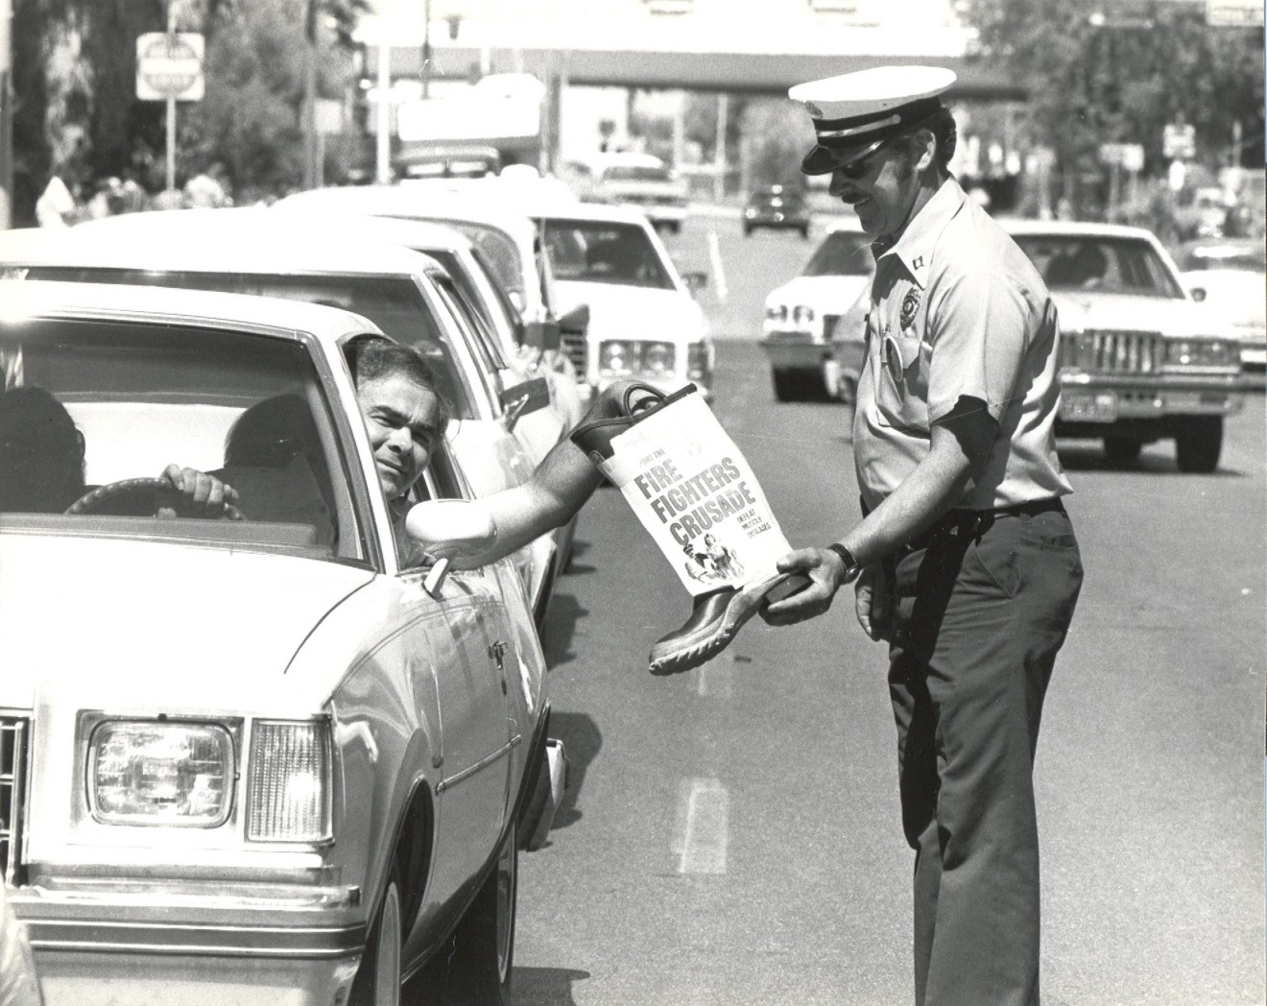
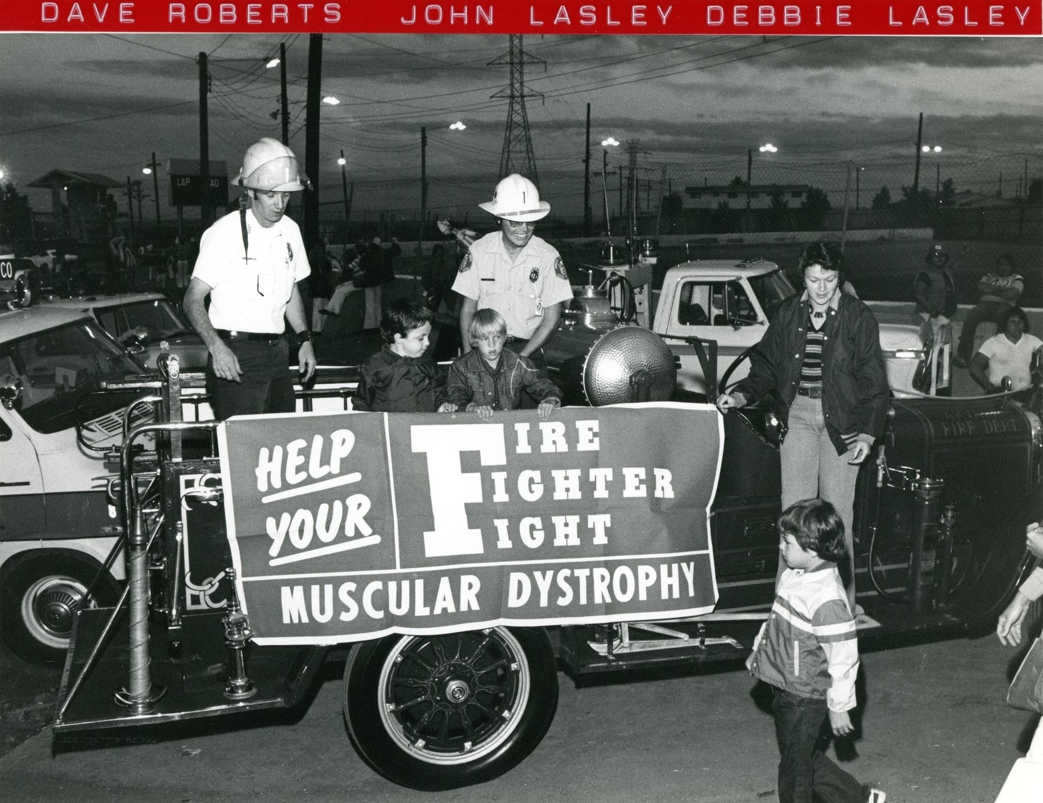
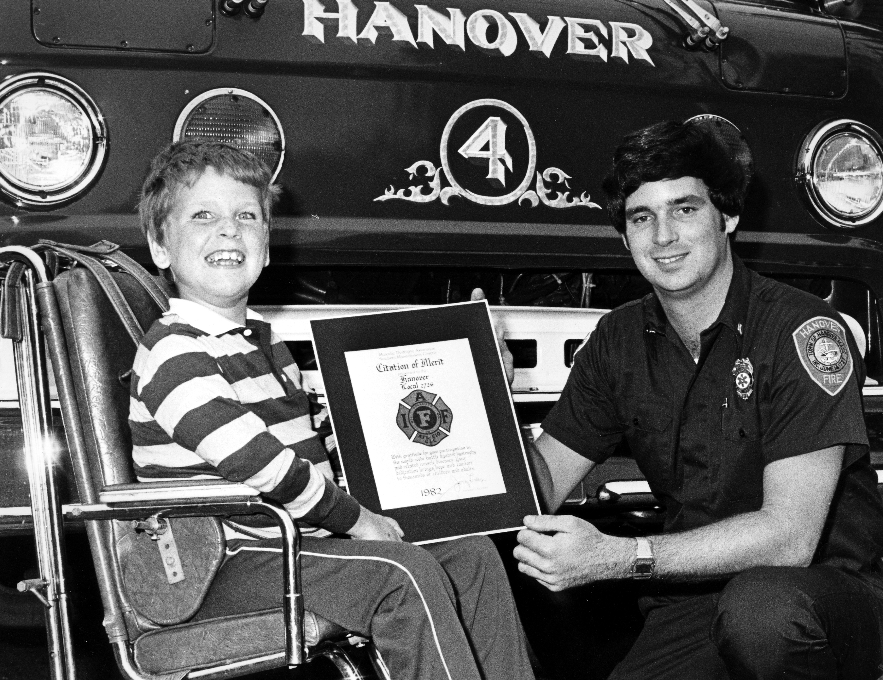
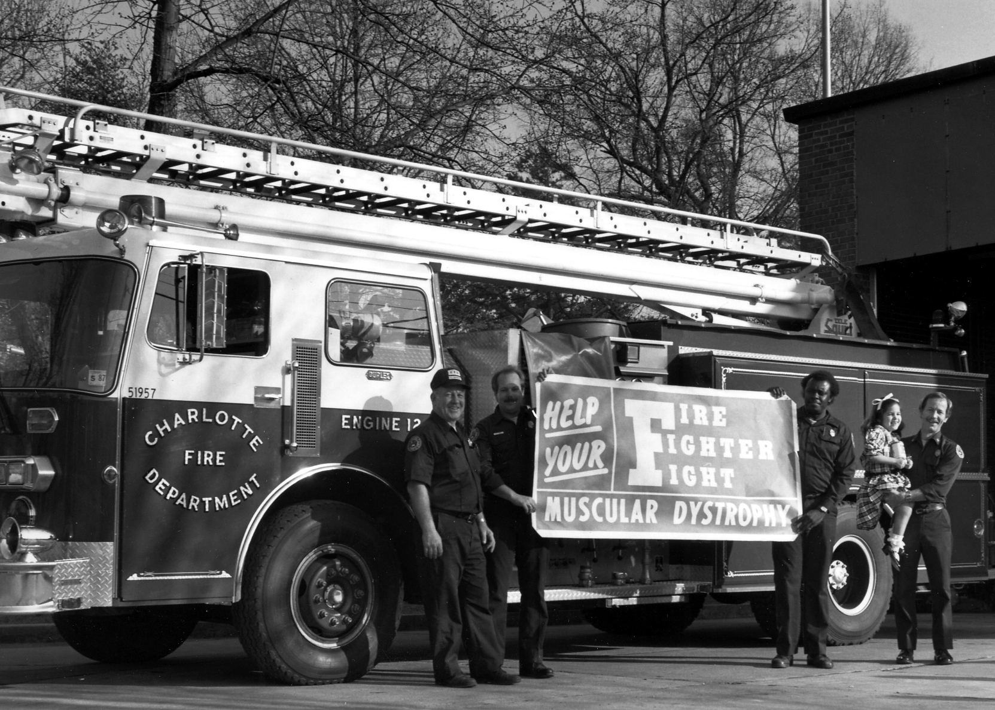
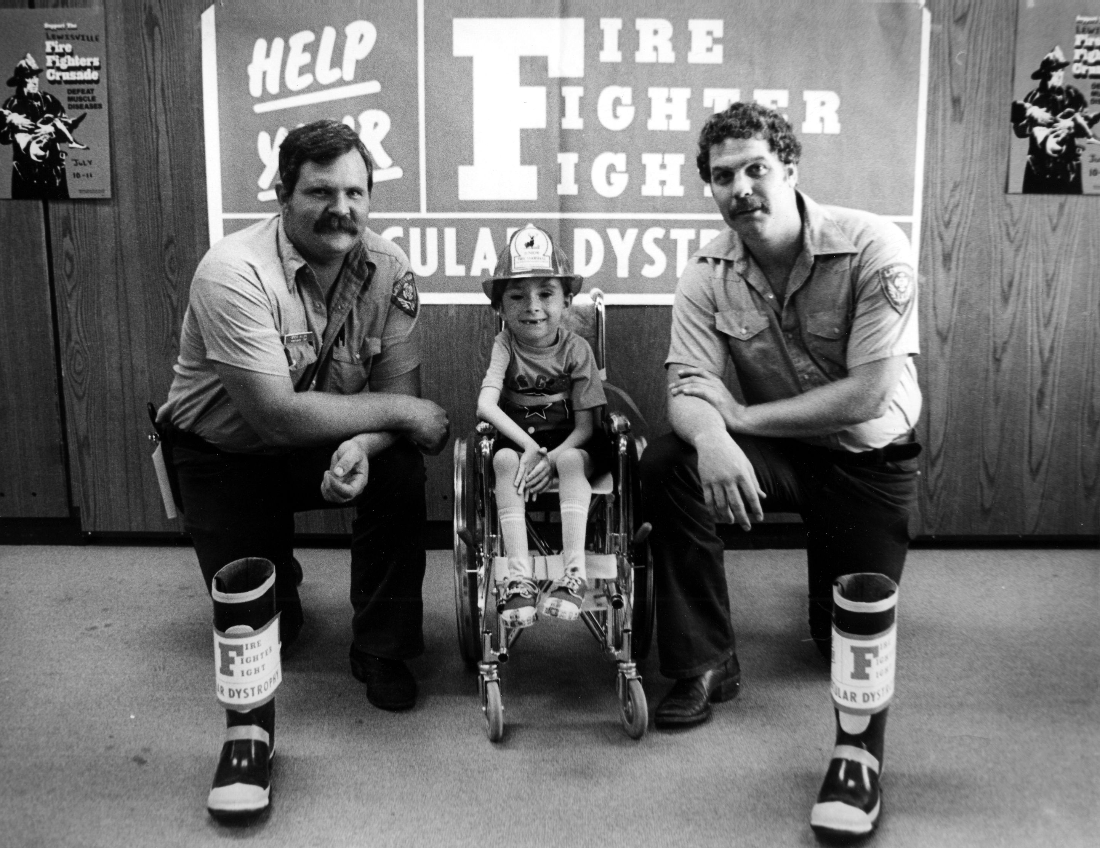
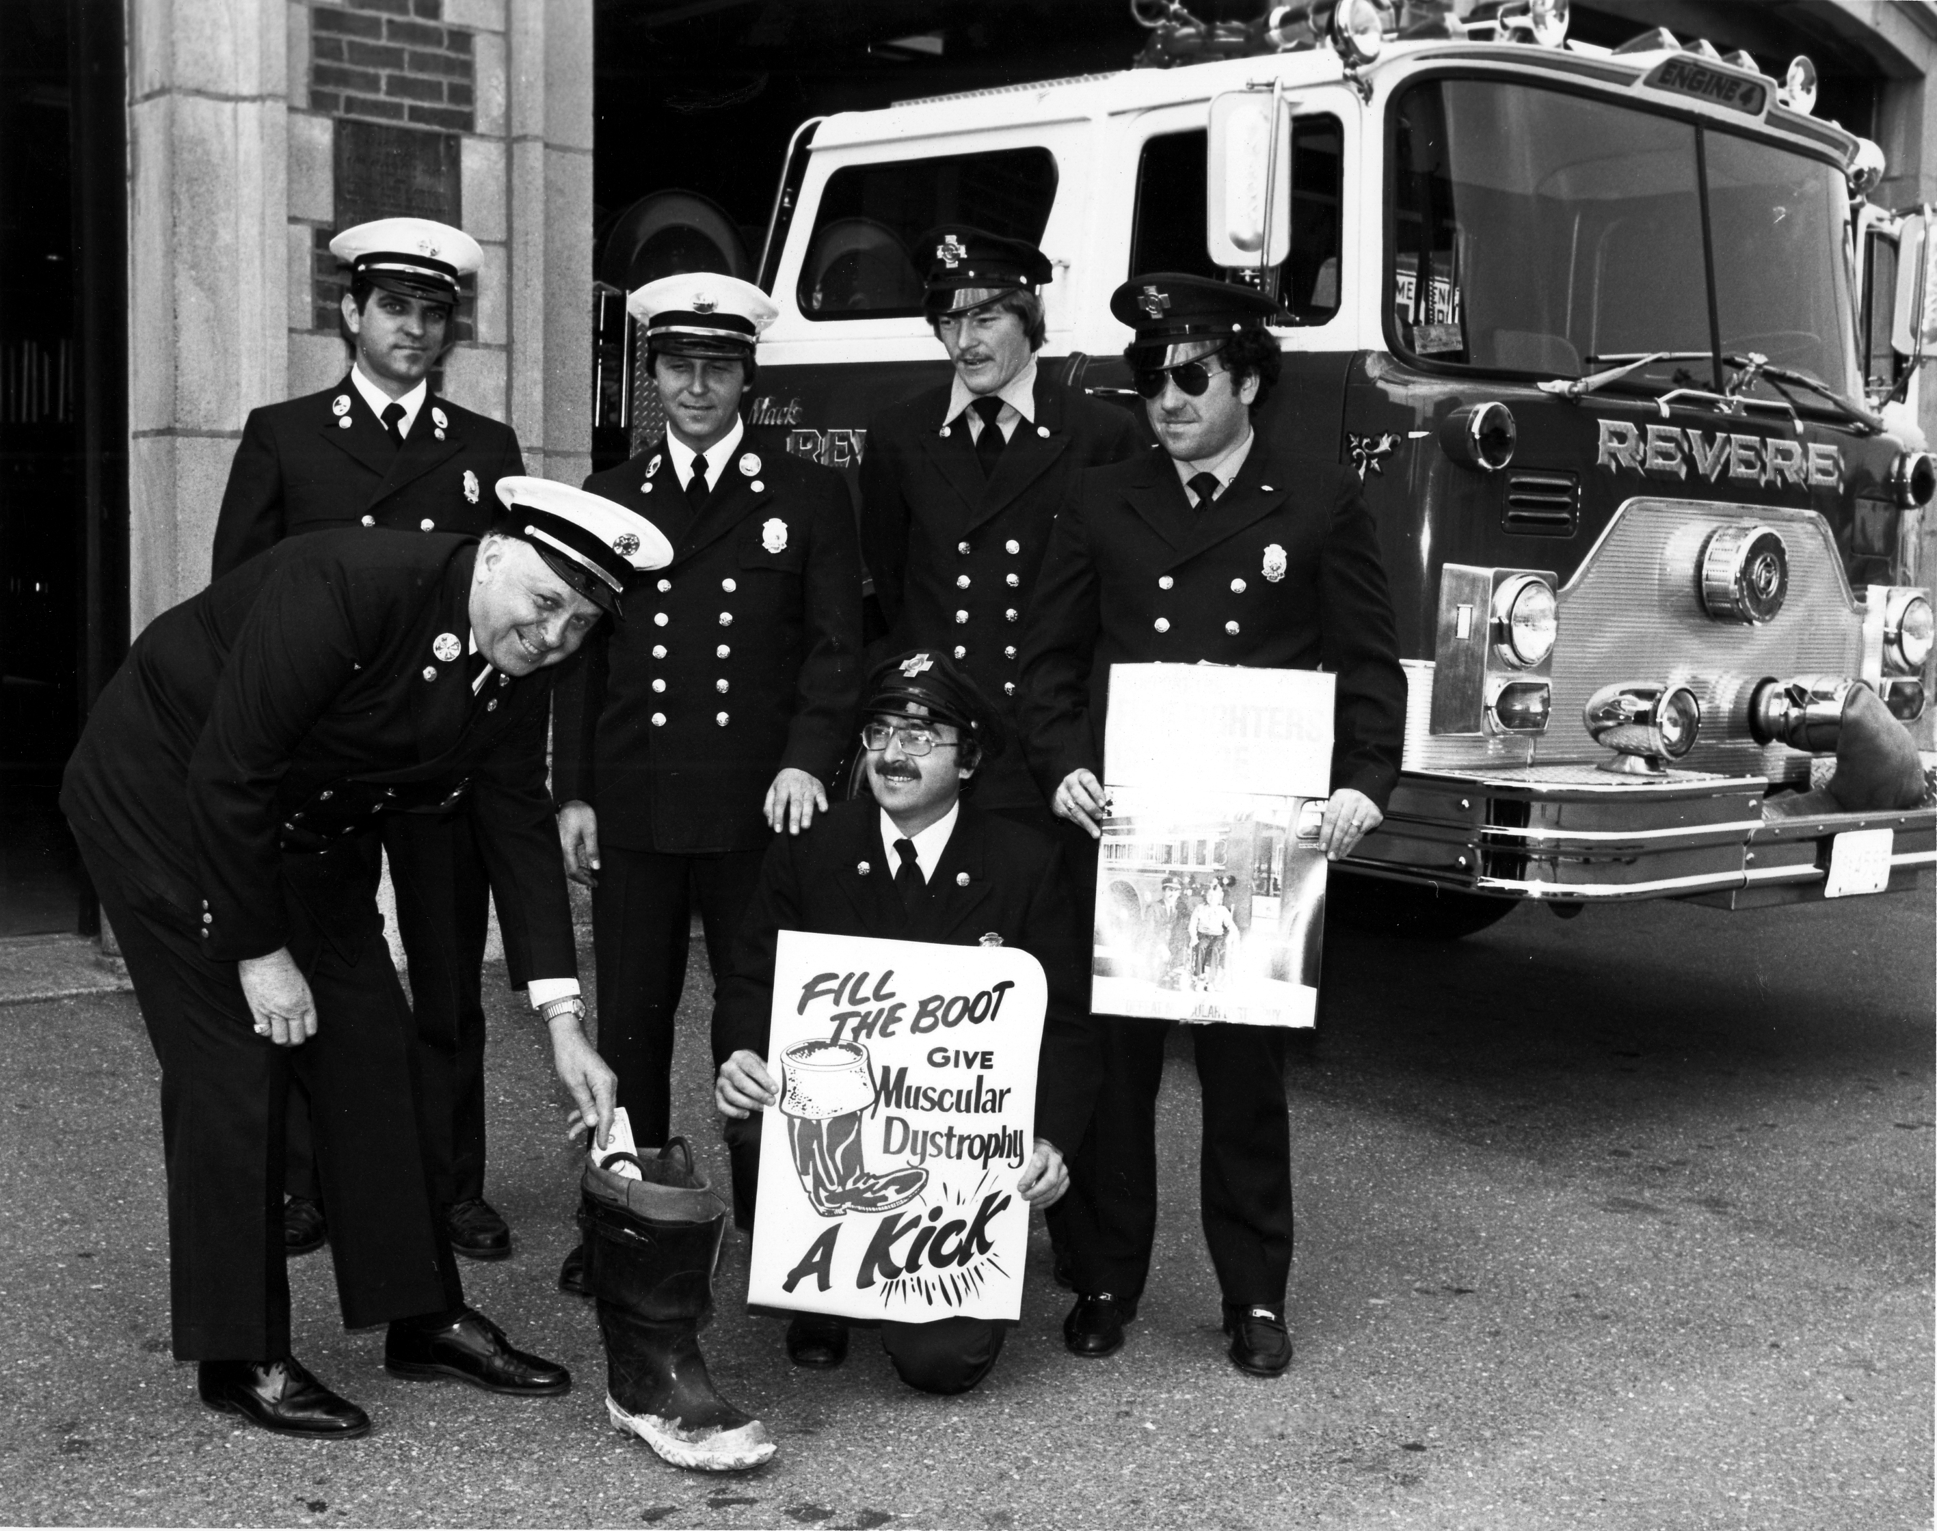
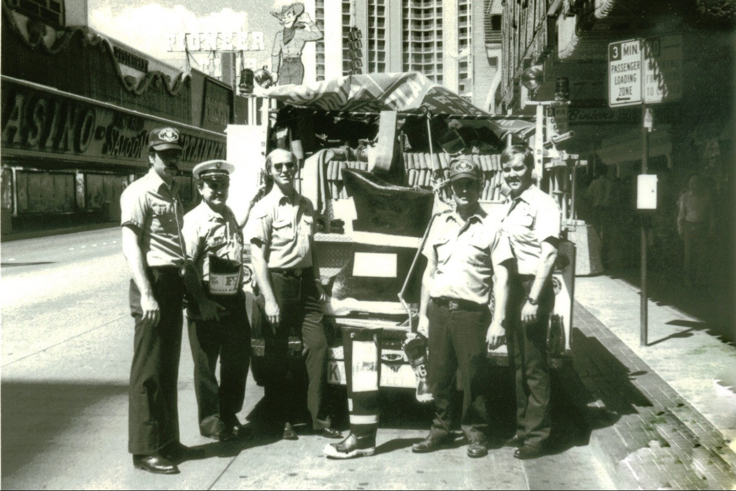
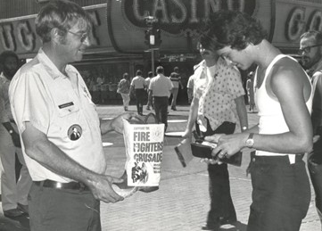
72 Years of Fill the Boot
1952: A father sought help at a Boston firehouse for his two sons living with Duchenne (DMD)
Fire fighter leadership: IAFF Local 718 President George Graney invited the family to share their story
Fire fighters act: 20 fire fighters raised $5,000 to support care for the children
1954: IAFF delegates unanimously launched a national partnership with MDA
Notes:
1952:
In 1952, Charles Crowley walked into a Boston firehouse looking for help for his two sons who were living with Duchenne muscular dystrophy. At the time, families had very few resources or answers, and he turned to fire fighters for support.
Fire fighter leadership:
George Graney, President of IAFF Local 718, listened to the family’s story and invited Crowley to speak at a union meeting, creating space for fire fighters to hear directly from a family in need.
Fire fighters act:
Moved by the story, 20 fire fighters went out into the community and raised $5,000, which was a remarkable amount in 1952 and demonstrated immediate, hands-on support.
1954:
Two years later, at the IAFF Convention, delegates unanimously committed fire fighters nationwide to fundraising for families living with neuromuscular disease, officially launching the IAFF–MDA partnership.

Slide 6
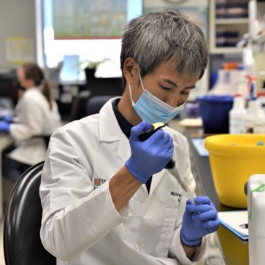
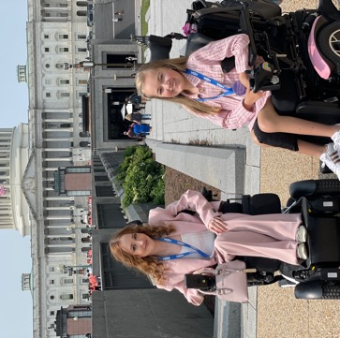
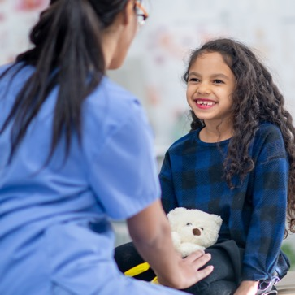
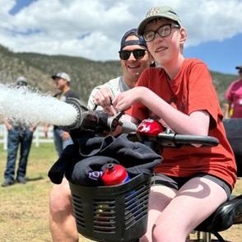
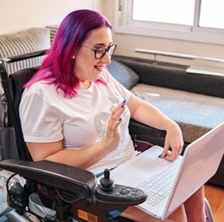
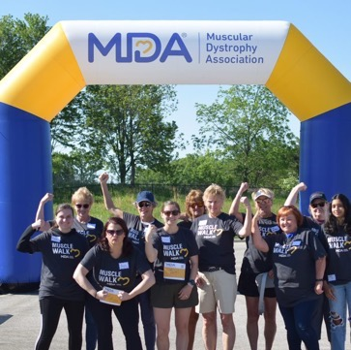
What We Do
Research
Advocacy
Access
to Care
Recreation
Education
Engagement
Notes:
This slide highlights the six core areas where MDA makes an impact for families and individuals living with neuromuscular diseases.
Speak to any State Specific Mission Metrics on this slide: Mission Metrics
Research = 30 treatments in last ten years, 6 in 2025
Advocacy = Newborn Screening
Access to Care = Care Centers
Recreation = Camp/Family Getaways
Education = Resource Center, MDA Connect, Engage Seminars,
Engagement = Muscle Walk, Family Events, Peer Connections, Community Groups
Research: We invest in cutting-edge science to discover new treatments and therapies. Since 2016, over 30 new therapies have been approved for families because of MDA-supported research.
Advocacy: We raise awareness and influence policies at the local, state, and federal levels to improve care and resources. For example, we helped add Duchenne muscular dystrophy to the federal newborn screening panel.
Access to Care: We connect families with clinics, specialists, and programs to ensure people get the care they need when they need it. Personalize it to the state
Recreation: Our summer camps, programs, and events give kids and adults a chance to just be themselves—have fun, make friends, and feel included.
Education: We provide families, healthcare professionals, and communities with accurate, up-to-date information about neuromuscular diseases.
Engagement: We create opportunities for families, volunteers, and supporters—like fire fighters through Fill the Boot—to get involved and make a tangible difference.
Overall, these six pillars show how MDA not only fights disease but also builds a supportive community for families.
The majority of every dollar goes directly to programs that serve families and advance our mission.
73 cents from every dollar in the boot goes directly back into these programs and services
A small portion, roughly 22 cents, covers Fill the Boot supplies, shirts, and other materials needed to run the program.
5 cents supports operations and management
In other words, most of the money raised through Fill the Boot and donations goes straight to helping families, funding research, care centers, camps, scholarships, and community support.

Slide 7
MDA Investment in California
Individuals Living with NMD
  35,800 individuals living with neuromuscular disease in California
MDA Care Centers
  Valley Children’s Hospital
  Community Regional Medical Center
  UC Davis Medical Center
  Stanford University School of Medicine (ALS Specialized)
  UC San Francisco Medical Center (Major Research Center)
  California Pacific Medical Center
Newborn Screening Program
  Pompe
  SMA
MDA Summer Camp
  The Painted Turtle – Lake Hughes, CA
    07/12/26 – 07/16/26
  Grizzly Creek Ranch – Portola, CA
    07/25/26 – 07/31/26
Annual Care Center Visits
  15,400+ visited MDA Care Centers in California in 2024

Slide 8
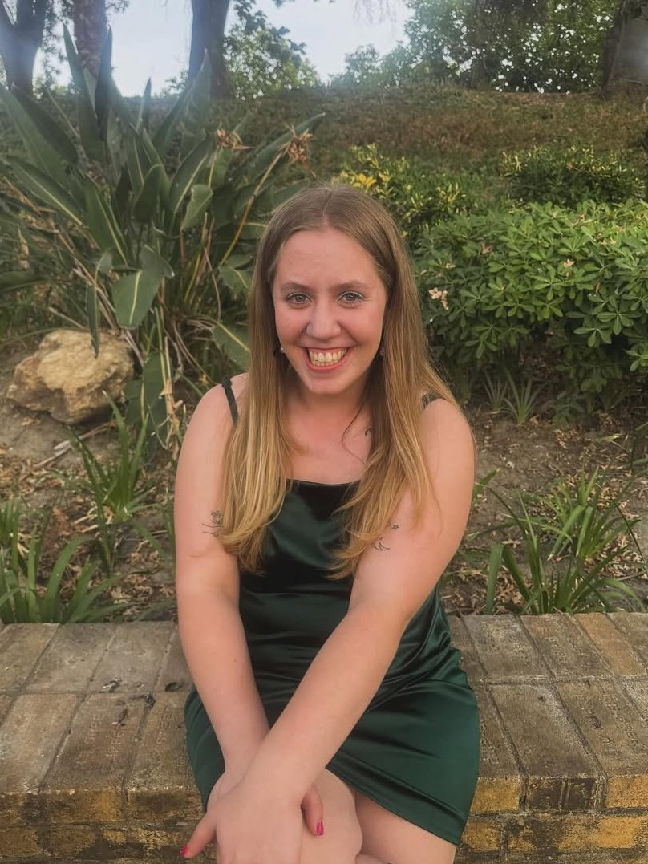
Support for MDA Families
CA_NatalieD_2026 Ambassador Profile
MDA Community Groups
MDA Peer Connections
MDA Resource Center
Gene Therapy Support
MDA Connect
Natalie; California
Notes:
MDA provides comprehensive support to families nationwide, ensuring that help and resources are never far away.
Key programs include:
MDA Community Groups – groups where families can connect and support each other virtually.
Peer Connections – one-on-one mentorship and guidance from someone who understands the journey.
Resource Center – a central hub for information, guidance, and tools to help families navigate everything from diagnosis to care options. (Highlight this as a primary resource for families.)
Gene Therapy Support Groups – specialized groups providing guidance and shared experiences for families exploring or undergoing gene therapy.
MDA Connect – a digital community platform to stay connected, ask questions, and share experiences with others in the NMD community.
Together, these programs ensure that families have support, guidance, and community wherever they are in the country, reinforcing that no one faces neuromuscular disease alone.

Slide 9
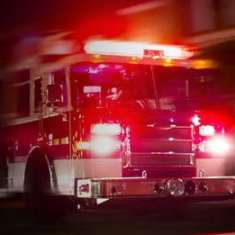
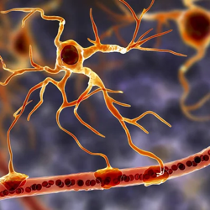
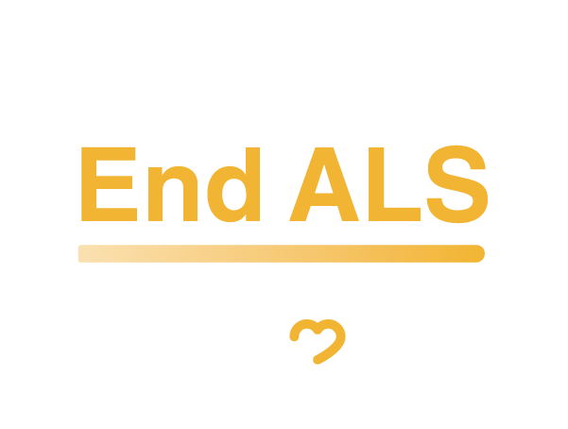
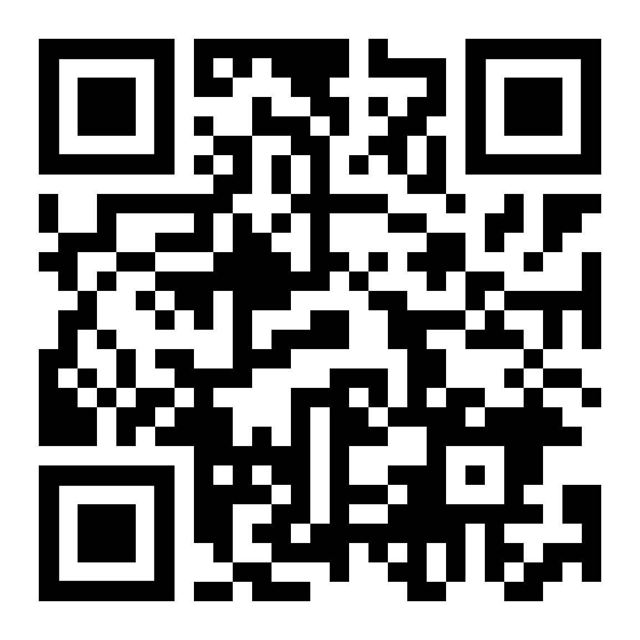
Advancing ALS Research for Fire Fighters
Some research suggests fire fighters may be twice
as likely to be diagnosed with ALS
The IAFF–MDA Joint ALS Initiative was established
in August 2024
MDA provides resources and support for fire fighters
and their families facing ALS
MDA has invested $200,000 in the national
Champions Insight ALS Study
Scan to learn more
about Champion Insights.
Notes:
https://www.mda.org/press-releases/muscular-dystrophy-association-supports-national-launch-of-champion-insights-study-to-investigate#:~:text=Get%20Involved&text=Muscular%20Dystrophy%20Association%20Supports%20National,Fighters%20and%20Other%20High%2DPerformance%20Populations
Champion Insights is a national research initiative led by Answer ALS, Augie’s Quest, and ALS TDI to better understand ALS risk in fire fighters and other high-performance groups.
MDA’s $200,000 investment ensures strong fire fighter representation in this research.
The at-home model helps remove common barriers like travel, scheduling, and mobility challenges.
Researchers are examining genetic traits, environmental exposures, and lifestyle factors that may contribute to increased ALS vulnerability.
While this study is independent, it reflects MDA’s broader commitment to learning more about the connection between firefighting and ALS.
That commitment includes funding projects like Champion Insights and establishing the Joint MDA–IAFF ALS Initiative in August 2024.
Together, these efforts support families and accelerate progress toward better treatments and cures.

Slide 10
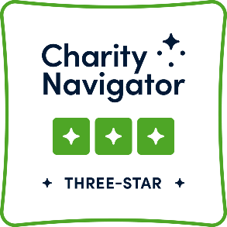
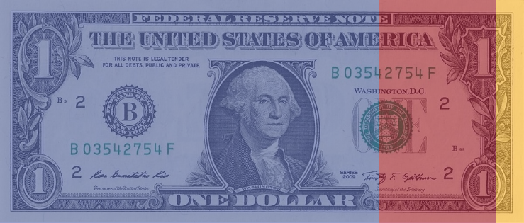
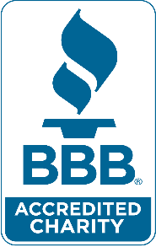

How Does MDA Spend $1?
22¢
supports
financial efforts
73¢
of every dollar helps fund MDA’s mission to empower people with neuromuscular diseases to live fulfilling
and independent lives through research, access to multidisciplinary care, community support, and advocacy.
5¢
supports operations and management
Notes:
Fire fighters often ask, “Where does the money go?”—and the answer shows the incredible reach of MDA programs and support.
MDA provides a lot of programs and services across research, care, advocacy, recreation, education, and community support—so every dollar has a big impact.
For the 2024 fiscal year (we’ll update with 2025 numbers once available):
The majority of every dollar goes directly to programs that serve families and advance our mission.
A small portion, roughly 22 cents, covers Fill the Boot supplies, shirts, and other materials needed to run the program.
In other words, most of the money raised through Fill the Boot and donations goes straight to helping families, funding research, care centers, camps, scholarships, and community support.
This transparency is one reason fire fighters trust MDA as a partner—you can see the impact of every dollar in action.

Slide 11
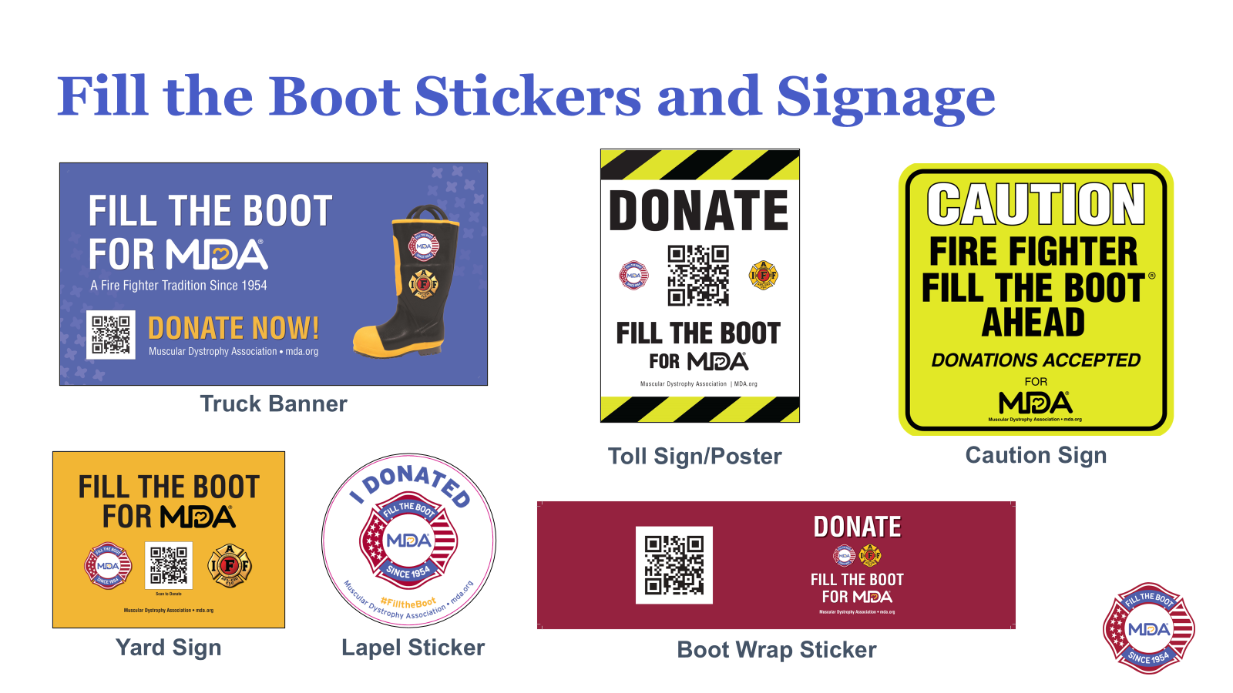
Fill the Boot Supplies

Slide 12
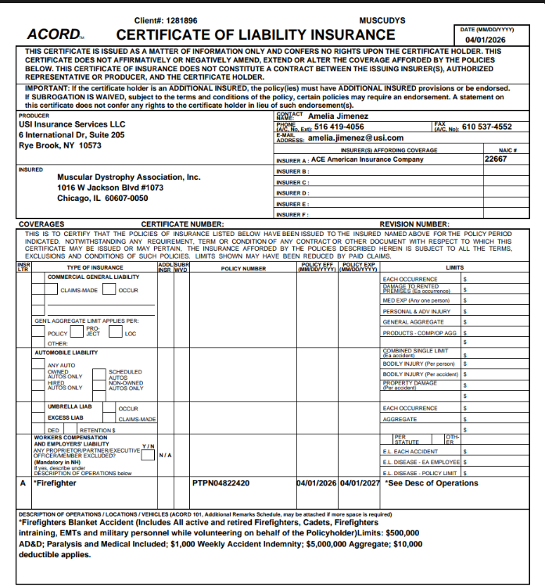
Insurance Coverage for
Fire Fighters
Blanket Coverage
  Includes Active and retired: Firefighters, Cadets, Firefighters in training, EMTs and military personnel

Slide 13
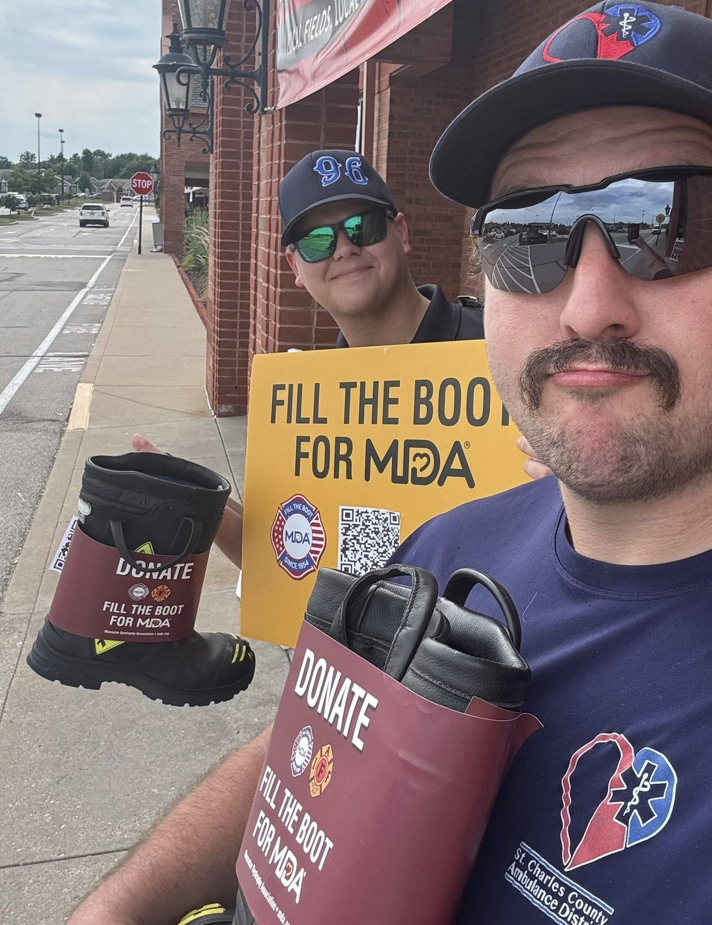
Ways to Participate
Intersection Boot Drive
Storefront Boot Drive
Sporting Events
Community Events
Get Creative
Notes:
Traditional Boot Drive:
Intersections or Storefronts
On or Off Duty
Sporting Events
Local Hockey Teams
MLB/ NFL Games
Community Events
Pancake Breakfasts
Concerts
Spaghetti Dinners
Parades​
Breweries​
Bags Tournaments
Get Creative – no one knows their community like they do!

Slide 14
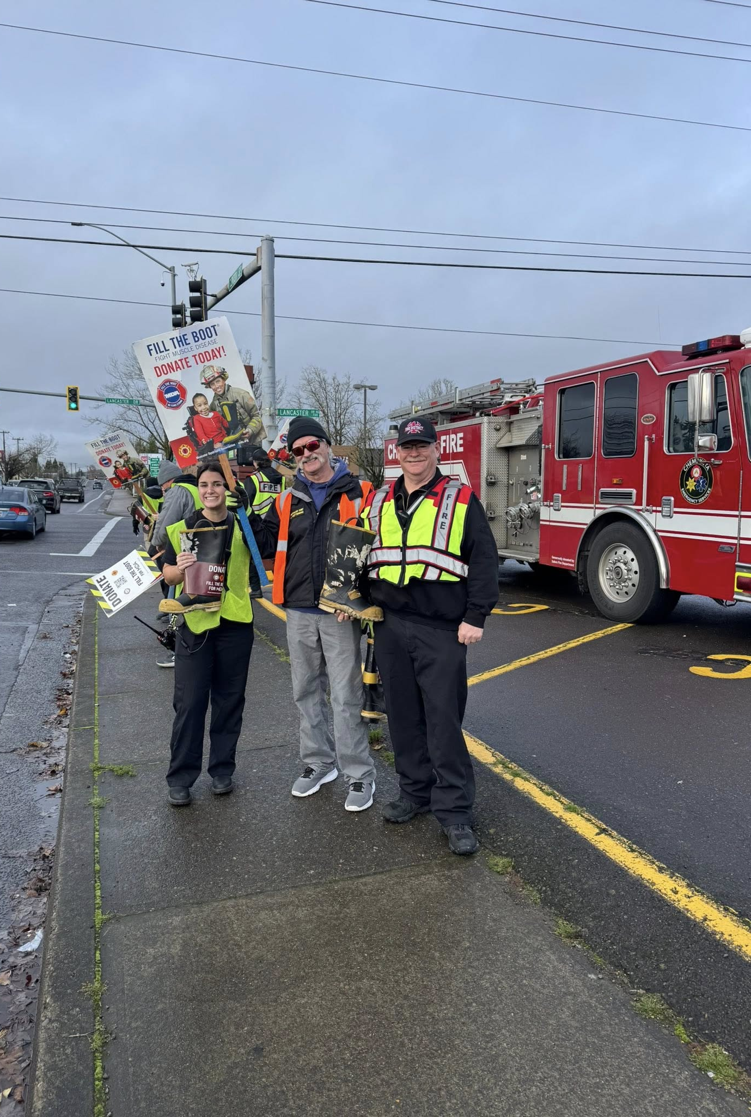
Fill the Boot in California
$74,257 L0112 Los Angeles City​
$47,138 L3631 Orange Co.​
$38,351 L2881 CAL FIRE MMU​
$30,224 L0776 Glendale​
$29,329 F0116 Vandenberg​
$22,487 L2881 CAL FIRE BTU​
$21,481 L2881 CAL FIRE TGU​
$21,389 L1289 Modesto​
$20,860 L2881 CAL FIRE TCU​
$18,333 L2881 CAL FIRE SDU​
Notes:
List the Top 10

Slide 15
Getting Started
STEP 01
STEP 02
STEP 03
UP identify a coordinator
Connect
with us
Fill the Boot
for MDA
Notes:
1. Identify a coordinator – if needed- a few places to look:
Add to Eboard member duties – ex. Treasurer
Add to new member duties- great way to get rookie involved
2. Connect with us
Once you have a plan for your collection, let us know so we can get the ball rolling on any other items including:
Permits
Supplies
Communication plans
3. Set collection dates/locations
Points to consider:
For fill the boot, will you be collection on the street? Or in front of stores?
Will you be collecting, on duty or off duty?
Whose permission will you need – Chief, admin, permits.
Feel free to reach out if you need help determining dates and locations.

Slide 16
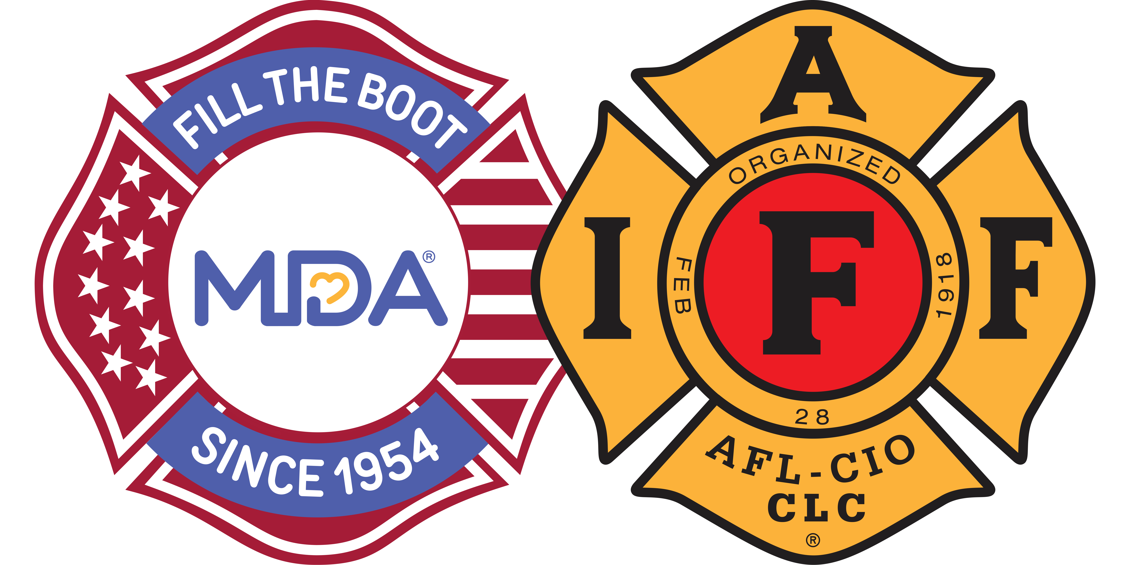
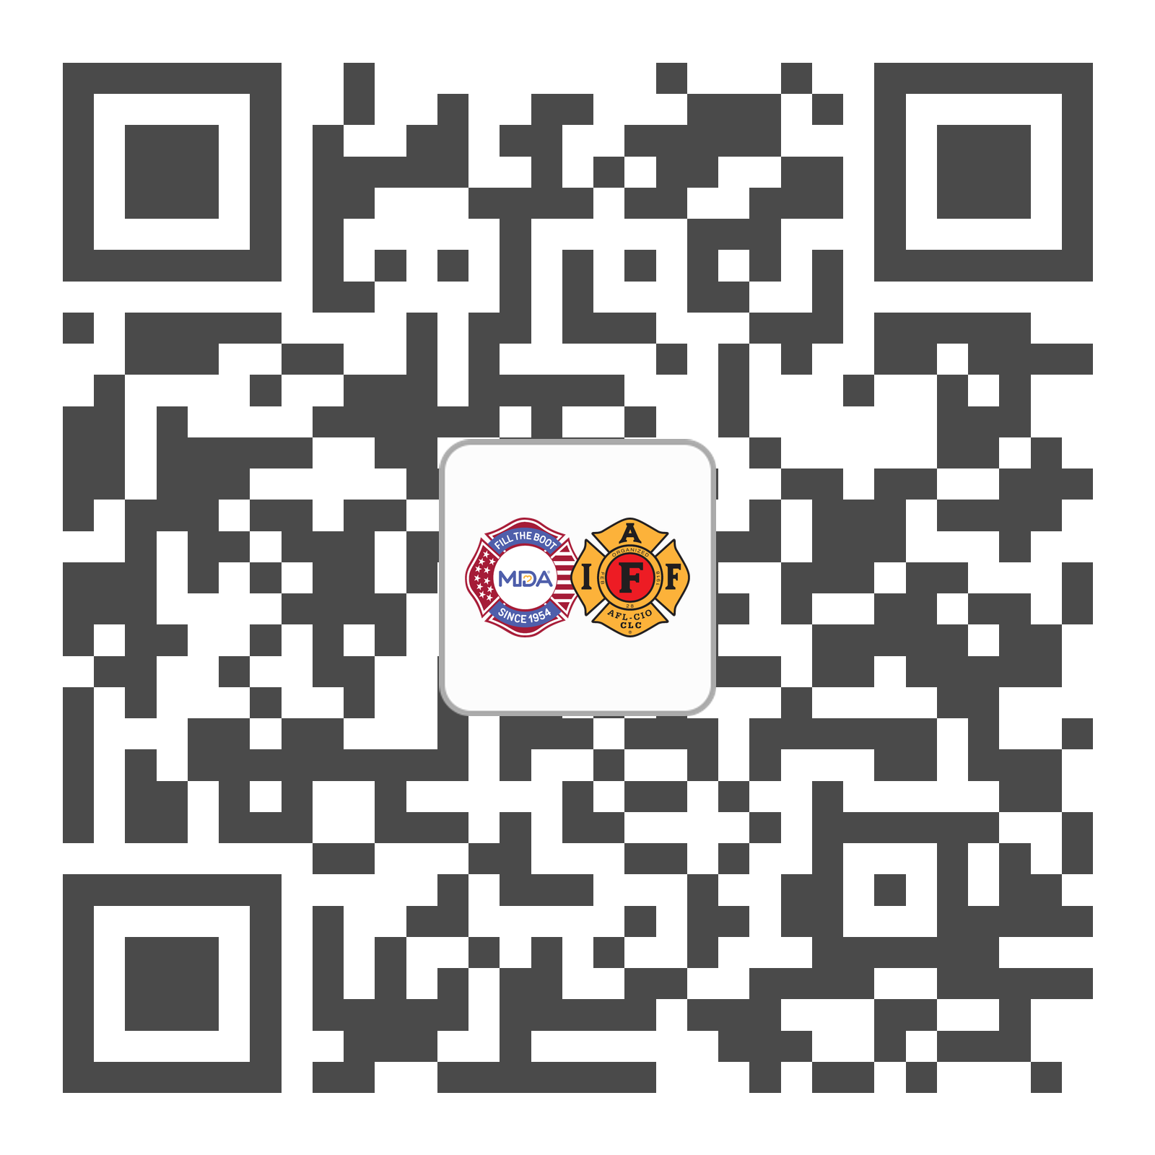
Thank You!
INSERT YOUR DIGITAL BUSINESS CARD
Angie Connell
(402) 215-8175
aconnell@mdausa.org
Fire fighters go where the fight is —
and we are grateful you fight for MDA’s mission!
www.mda.org/filltheboot/iaff

