Slide 1
Community Update
Atwater’s Measure B & Municipal Election Information
Fall 2022

Slide 2
What is Measure B?
Current voter-approved Public Safety Funding which generated approximately $2 million a year, expires in June 2023.
Measure B is a one-cent special purpose tax that, if enacted, would be used to continue to fund local police and fire public safety services after the existing voter-approved funding expires.

Slide 3
Official Measure B Ballot Question
City of Atwater Police, Fire, 911 Emergency Response Renewal Measure. To prevent drastic cuts to Atwater’s public safety services, including elimination of Atwater’s Police Department; maintain emergency heart attack/stroke response times, medical services, fire protection, neighborhood police patrols, police officer training; investigate violent crimes; shall the City of Atwater adopt a measure renewing its existing, voter-approved sales tax at the 1¢ rate, providing $4,000,000 annually, until ended by voters, requiring audits, oversight/all funds only for Atwater?
YES | NO

Slide 4
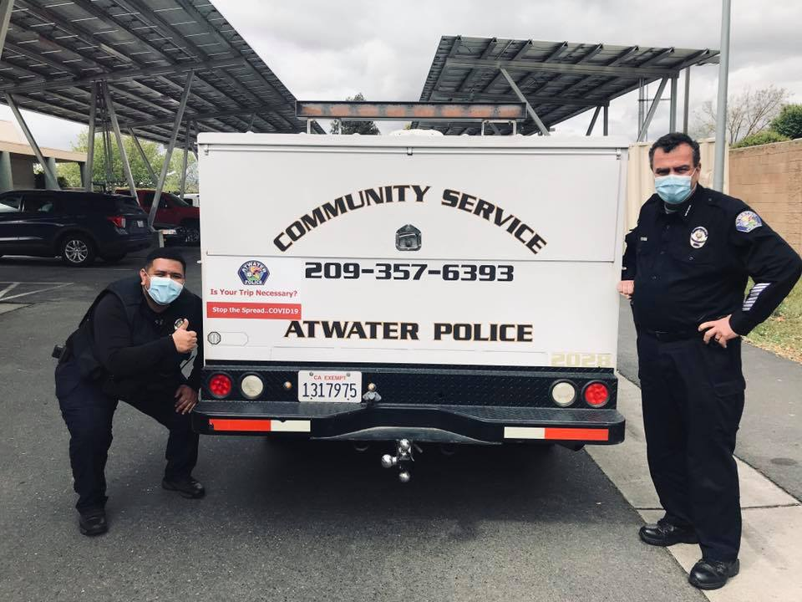
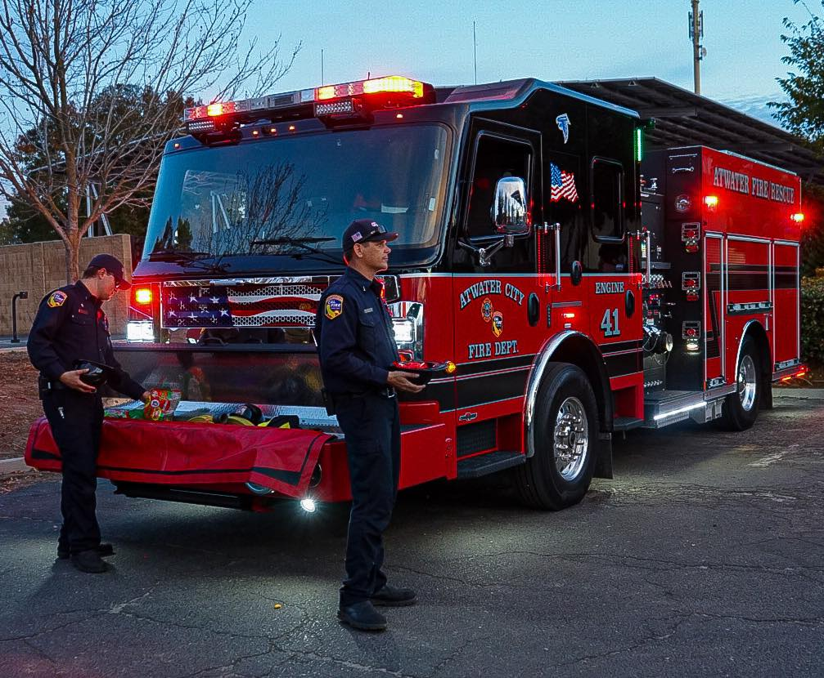
What is it for?
Atwater police officers and firefighters help prevent crime, address homelessness, and provide emergency response.
Local police officers and firefighters also volunteer in the community and provide support to our local businesses.
If enacted, Measure B can generate funding that can be used to help continue to retain our local police officers and firefighters.

Slide 5
Community Identified Public Safety Priorities
Through Let’s Talk Atwater, residents identified current public safety priorities that Measure B can be used for, such as helping to prevent reduction of the Atwater Police Department, maintaining emergency medical response services, providing police officer training, and investigating violent crimes, all priorities identified by the Atwater community in a survey earlier this year.

Slide 6
Will Measure B Address Our Local Fire Needs?
Atwater firefighting levels are significantly below the national staffing standards making responses to emergencies more difficult if there is more than one at a time.
If enacted, Measure B can provide funding for firefighting and emergency response services.

Slide 7
Measure B Financial Protections & Local Control
As a local measure, Measure B funds will remain locally-controlled by the City of Atwater.
If enacted, Measure B is subject to annual independent financial audits and public review of expenditures by the Citizens’ Oversight Committee.
Measure B does not apply to food purchased as groceries or prescription medication.

Slide 8
What else is on Atwater’s Municipal Ballot?
In November, Atwater voters will also have the opportunity to elect the City’s Mayor and two City Councilmembers.

Slide 9
ADDITIONAL VOTER INFORMATION
For the full text of Measure B and Municipal Election information, visit: www.Atwater.org
Permanent Vote by Mail Voters should receive their ballot the week of October 10th
To track your ballot visit: california.ballottrax.net
Poll voting will occur on Tuesday, November 8th. Polling places will be open on Election Day from 7am-8pm. Vote by Mail Ballots can be dropped at any polling place in the County on Election Day.
For more information on voting or for any questions, visit the County Registrar of Voters at: www.CountyofMerced.com/Elections

Slide 10
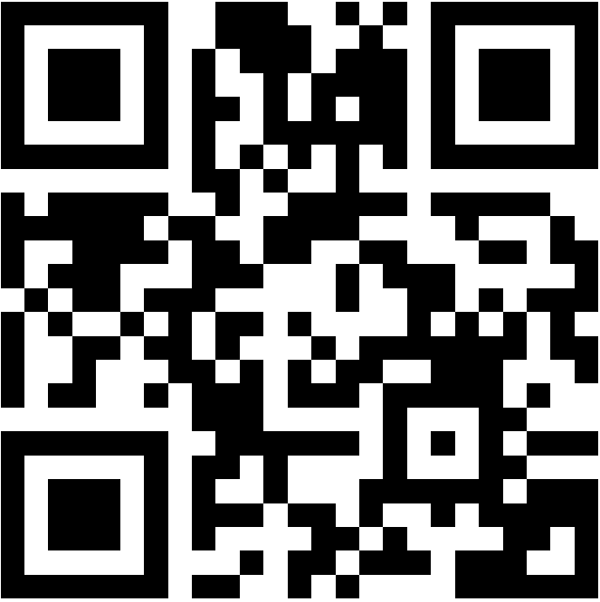
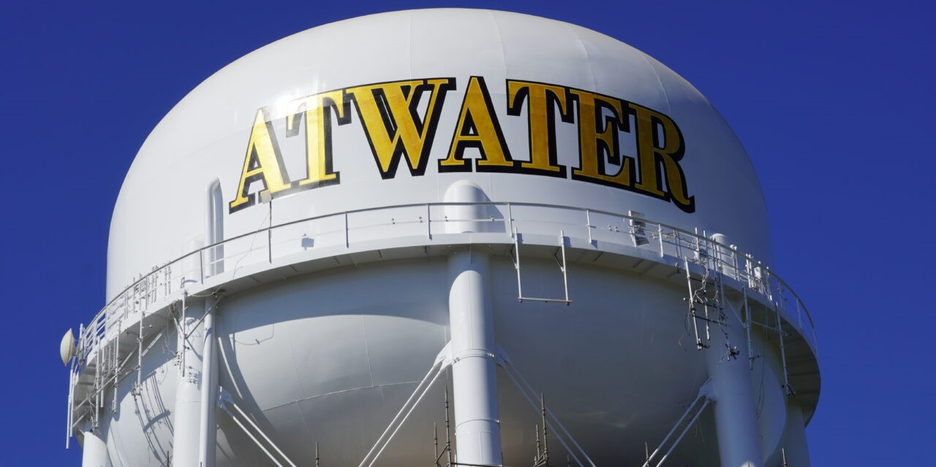
Where can I get more information?
Visit: www.Atwater.org

